Slide 1
Big Mountain Ski Resort:
Data-Driven Ticket Pricing
Caitlin Ruble
Springboard Data Science
01/24/2022

Slide 2
Problem and Goal
New Chair Lift $1,540,00/season
(already installed)
Current Ticket Price $81.00/person/day
How can Big Mountain choose a new, data-driven ticket price to make up for their increased operating costs for the new chair?
Or, can Big Mountain change operations within the park to reduce costs and maintain revenue with the new chair?

Slide 3
Recommendations
Based on our model derived from nationwide ski resort data, assuming 350,000 visitors for the season, each staying for 5 days:
Big Mountain can support a ticket price of:
This leads to a change in seasonal revenue of:
$95.81 ± $10.39
~$26 million ± $18 million

Slide 4
Modelling
Our target metric was weekend ticket price, chosen because weekday price was omitted from much of our sample set.
We included all states in our analysis model because we found that, while inter-state prices generally clustered together, the state did not ultimately predict ticket price.
We tested both a linear regression model and a random forest regression model.
The random forest model shows less variability and more consistent results, and was chosen for the final model.

Slide 5
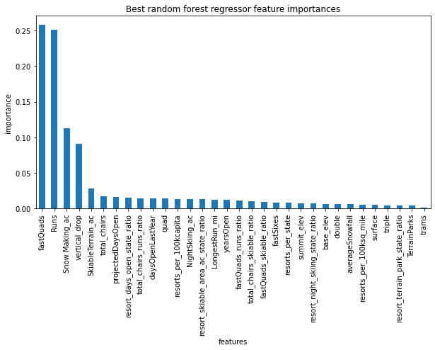
Random Forest Model Key Features
Most important features to determine price:
Number of fast quads
Number of runs
Snow-making acreage
Length of Vertical Drop

Slide 6
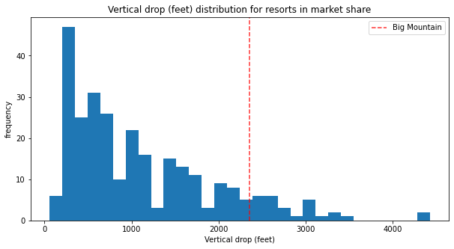
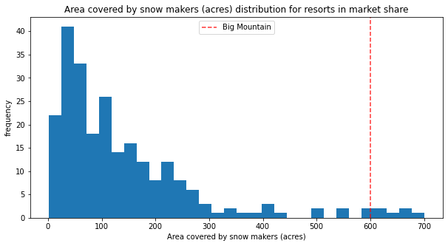
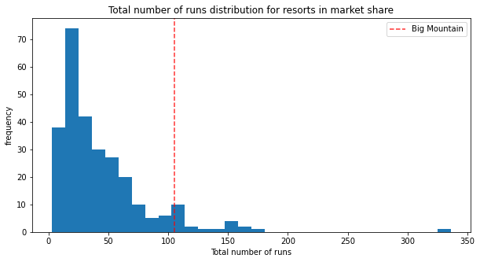
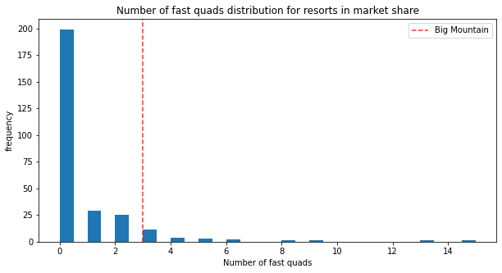
Big Mountain was among the most well-appointed resorts nationwide for our key features

Slide 7
Summary and Conclusion
Big Mountain is well poised in the nation-wide market share to increase it’s ticket price significantly to $95.81 ± $10.39
Even at the low end of this range, Big Mountain can generate revenue to more than cover the increased cost of the new chair lift
Future business decisions should focus on modifications to the top four features of our model:
e.g.1: Big Mountain could close 3-5 runs with minimal effect on ticket price and potentially a big effect on operating costs
e.g.2: A new run and chair that increased the length of the vertical drop would support an additional $1.99 increase in ticket price

